Slide 1

Learn Persian with ziba
The Persian Alphabet

Slide 2




m → man | n → nut
d → Dave | z → Zack
Name: Meem
Name: Noon
Name: Dāl
Name: Zāl

Slide 3
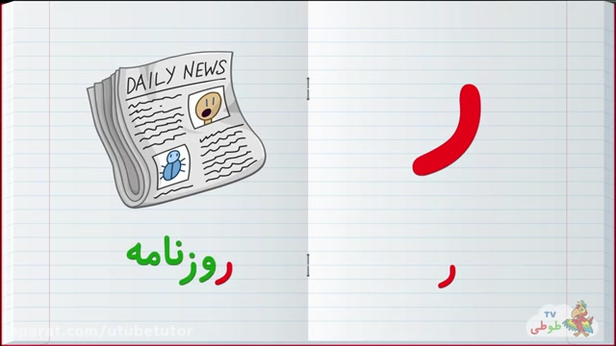
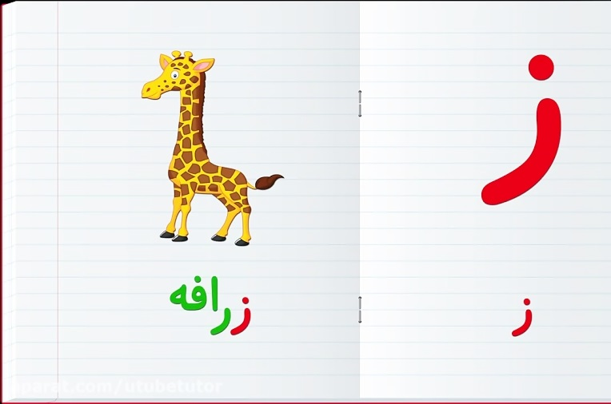

r → Rob | z → Zack
 | More examples of ‘Zhe’: -pleasure -usual -measure -sabotage -beige
ʒ → vision
Name: Rè
Name: Zè
Name: Zhè

Slide 4

Transliteration
write from right to left!
nādān
nām-e man
Adab
Bā adab
Tārā
Mard
Ān mard
Rāz
Rāz dār
Ārām
Barādaram
Bāzār
Por az ārd
Zhān
Mā dar rom
Benz-e bezh
Mazdā
Boz
Ābād
Damā
Āmadam
tamām

Slide 5
write from right to left!
bābā āb dād.
bārān nam nam āmad.
manā dandān dard dārad.
man ba monā āmadam.

Slide 6




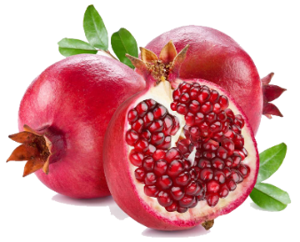
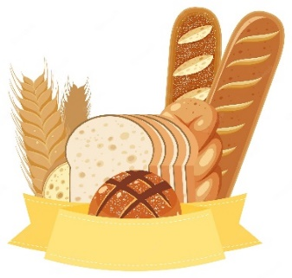
بادام | مامان
اَبر | باران
اَنار | نان

Slide 7






دامَن | دَر
مِداد | دَندان
مار | زَرد

Slide 8





پَر | بَبر
پِدَر | مادَر
ژاپُن | پاندا

Slide 9
بابا نان، اَنار را بُرد.
پاندا پَر نَدارَد.
مَن مِداد زَرد دارَم.
آپارتِمان دَر بِژ دارَد.
مامان دَر مازَندَران ماند.
مار بَدَنِ دِراز دارَد.
1.2.
3.
4.
5.
6.
1. Dad took away the bread, pomegranate
2. Panda doesn’t have got feather(s).
3. I have (a) yellow pencil.
4. The apartment has got (a) beige door.
5. Mom stayed in Mazandaran.
6. Snake(s) has got (a) long body.
= took away
= doesn’t have
= (I ) have
= (it) has
= (she) stayed
= in
=long
= body

Slide 10





Answer key
nādān
nām-e man
Adab
Bā adab
Tārā
Mard
Ān mard
Rāz
Rāz dār
Ārām
Barādaram
Bāzār
Por az ārd
Zhān
Mā dar rom
Benz-e bezh
Mazdā
Boz
Ābād
Damā
Āmadam
tamām

Slide 11


bābā āb dād.
bārān nam nam āmad.
manā dandān dard dārad.
man ba monā āmadam.

